Slide 1
Blueberry Cultivars for the Southeastern US
Bill Cline, Entomology and Plant Pathology
North Carolina State University

Slide 2
Blueberries
Vaccinium species
Heath family (Ericaceae)
Native to North America
Related to azaleas, cranberries
Acid-loving plants that require low soil pH
Multi-trunked bush, deciduous woody perennial
Requires winter chilling
Pollinated by insects
Hand- or Machine-harvested for fresh or processed (frozen, canned)

Slide 3
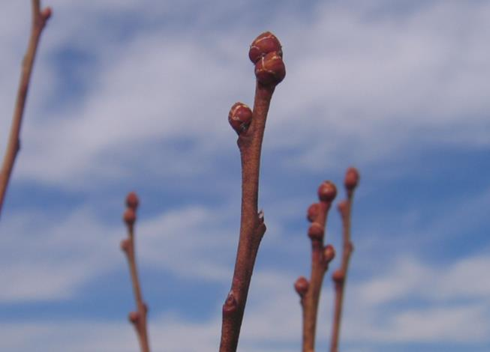
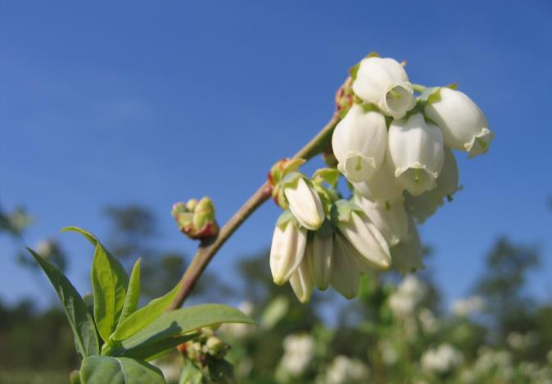
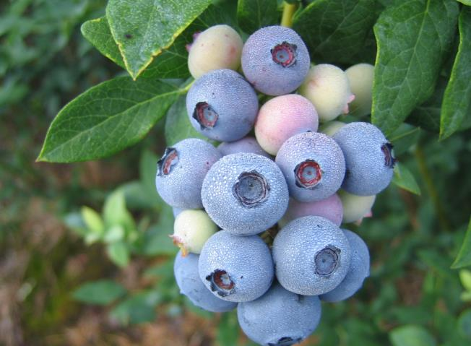
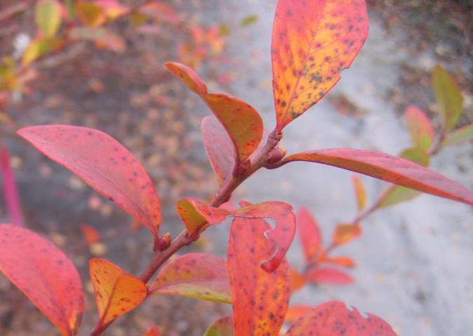
WINTER
SPRING
SUMMER
FALL

Slide 4
Culture and Management
Pollination
An insect must visit each flower or a berry will not form
For cross-pollination, plant more than one cultivar
Pruning
Annual task, usually in dormant season
Removal of old or weak canes; shaping & thinning
Irrigation
Drought relief (drip, micro-sprinklers, overhead)
Freeze protection (overhead only)
Fertilizer/Organic matter
Fertilizer use is based on soil testing
Must maintain low pH for the life of the planting
Pine bark, aged sawdust

Slide 5
Blueberry flowers must be visited by a pollinating insect in order to form a berry. The Southeastern Blueberry Bee (shown) is a very effective wild, native pollinator.

Slide 6
Unpollenated berries do not size, turn red and fall off 2-3 weeks after bloom

Slide 7
Blueberry bushes are pruned each winter to shape, thin and manage height
Before Pruning
After Pruning

Slide 8
Overhead vs Drip Irrigation
Overhead can be used for freeze protection in Spring; high volume
Drip conserves water, avoids wetting bush

Slide 9
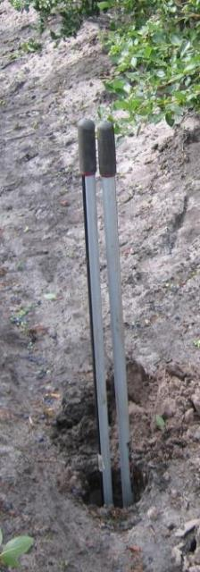
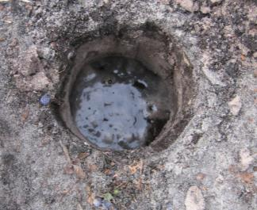
The best native NC blueberry soils are organic sands (>3% organic matter) with a water table within 12-24” of the surface; fields are bedded to improve root aeration.

Slide 10
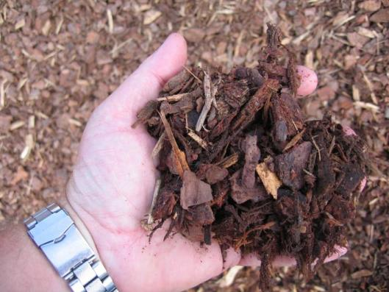
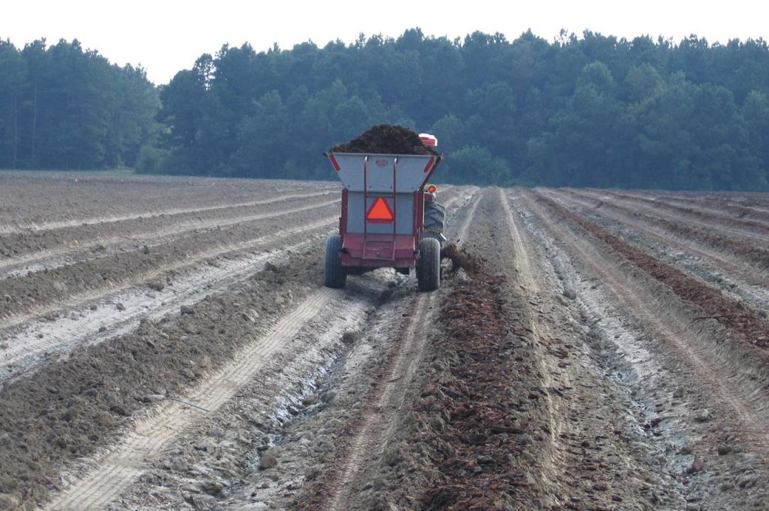
ON UPLAND SITES, Bark mulch is added to provide an organic substrate, lower pH and improve drainage. Note raised beds!

Slide 11
Site evaluation and soil type helps determine what cultivars you can grow

Slide 12
Raised beds amended with pine bark, then surface mulched, with sod middles

Slide 13
SPECIES OF CULTIVATED BLUEBERRY GROWN IN THE SOUTHEASTERN US
Rabbiteye (Vaccinium virgatum syn. V. ashei) native to deep South, hexaploid 6X
Highbush (Vaccinium corymbosum) “Northern highbush” domesticated in NJ, but also native into the South; tetraploid 4X
Southern highbush (Vaccinium corymbosum X ?) complex tetraploid 4x interspecific hybrids with lower chill requirement, greater soil adaptability
Pentaploids (5x) hybrids between rabbiteye & highbush (rare, not widely grown or widely recommended)

Slide 14
LOCATION DRIVES CULTIVAR SELECTION
Chill hours = hours below 45ºF required to leaf and flower normally (Oct to Feb in NC)
Soil type and % humic matter
USDA Hardiness Zone
Poor leafing due to lack of
winter chilling (hrs < 45º F)

Slide 15
Chill Hour requirements vary by species and also by cultivar within species
SPECIES/TYPE | CHILL HOUR RANGE | USDA HARDINESS ZONE
HIGHBUSH | 800 TO 1200+ | 3-7
RABBITEYE | 400 TO 800+ | 7-8
S. HIGHBUSH | 150 TO 900+ | 7-10

Slide 16
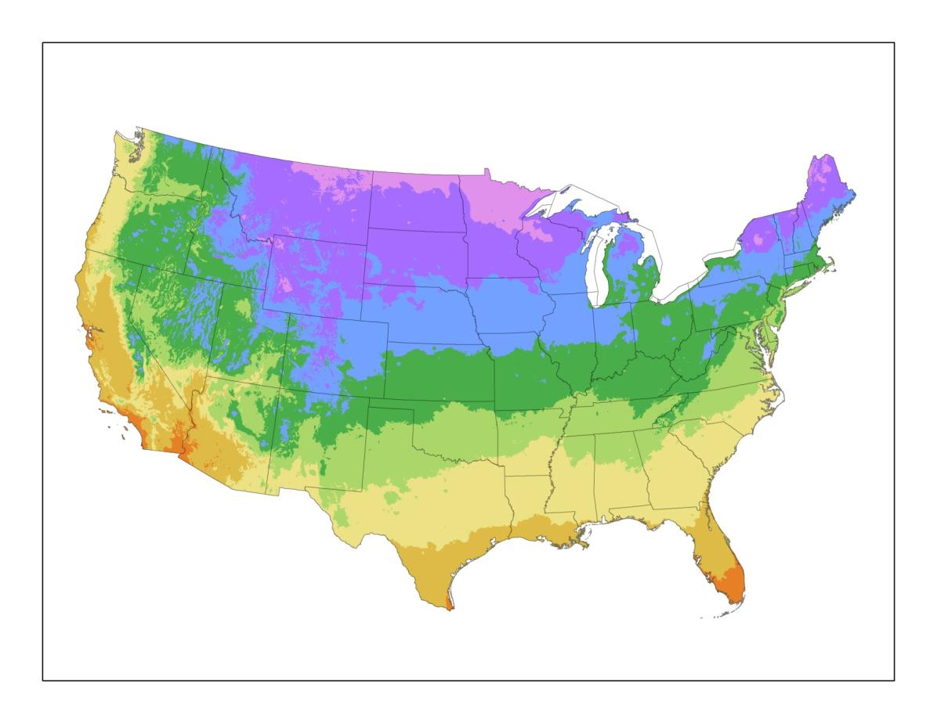
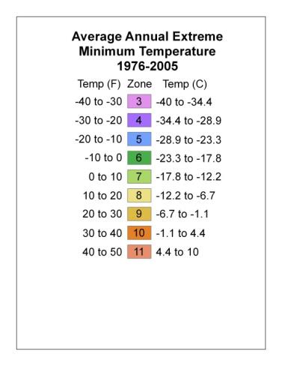

Slide 17
NORTH CAROLINA AS AN EXAMPLE:
Highbush is preferred for NC mountains above ~2,500 ft (too cold for other types)
Rabbiteye in foothills, piedmont and drier areas of the coastal plain (soil adaptability, drought tolerance)
Southern highbush and selected highbush main coastal production areas on amended or native sites (early ripening)

Slide 18
Research your choices, ask specialists, agents, growers -- “I wouldn’t grow that one because…”
Stems don’t detach
Cracking
Wet stem scar
Too soft
Poor flavor (esp. tart)
Disease
Color (too dark)
Size
Poor bush survival
Market prejudice (species, size, color)
Ripens too late
Yield not consistent
Yield too low
Won’t machine pick

Slide 19
Fruit color comparison – ‘Onslow’ (Left) vs ‘Columbus’ (right)

Slide 20
LOCAL testing & evaluation is very important – esp. on-farm with growers
Mike Mainland, Hort Sci Emeritus Prof.

Slide 21
Blueberry harvest timing by cultivar in southeastern NC
 | MAY |  |  |  |  |  | JUNE |  |  |  |  |  | JULY |  |  |  |  |  | AUGUST |  |  |  |  |  | SEP
CROATAN
REBEL
O’NEAL
SUZIBLUE
STAR
FARTHING
ABUNDANCE
DUKE
NEW HANOVER
CAMELLIA
LEGACY
PREMIER
COLUMBUS
TIFBLUE
POWDERBLUE
BLACK =HIGHBUSH GREEN = SOUTHERN HIGHBUSH RED = RABBITEYE

Slide 22
Highbush Cultivars for zones 3-7, well-drained amended soils with irrigation. Most cold tolerant, for mtns
STANDARDS: Earliblue, Patriot, Bluecrop, Berkeley, Jersey, Elliott
NEWER: Duke, Aurora, Liberty, Draper
‘DUKE’

Slide 23
Rabbiteye Cultivars (Zones 7-8) most common backyard and Pick-Your-Own in the South, mostly on irrigated, amended upland sites
STANDARDS: Premier, Climax, Brightwell, Tifblue, Powderblue
NEWER: Vernon, Krewer, Alapaha, Columbus, Ira, Ochlockonee, Onslow
‘IRA’

Slide 24
Southern Highbush Cultivars -- SE Coastal Plain areas, Zones 7-10, optimal “native” sites or well-drained, irrigated and amended uplands
STANDARDS: O’Neal, Star, New Hanover, Legacy
NEWER: Rebel, Suziblue, Farthing, Camellia, Gupton
‘LEGACY’

Slide 25
QUESTIONS?

