Slide 1
Some Economic Considerations for Blueberry Production in the Southeast
Bill Cline, Entomology and Plant Pathology
North Carolina State University

Slide 2
Commercial blueberry acreage in North Carolina by County, 2015. Total 9,756 acres
County | Acres
Bladen | 5,859
Pender | 2,092
Sampson | 1,012
Duplin | 501
Columbus | 165
Craven | 127

Slide 3
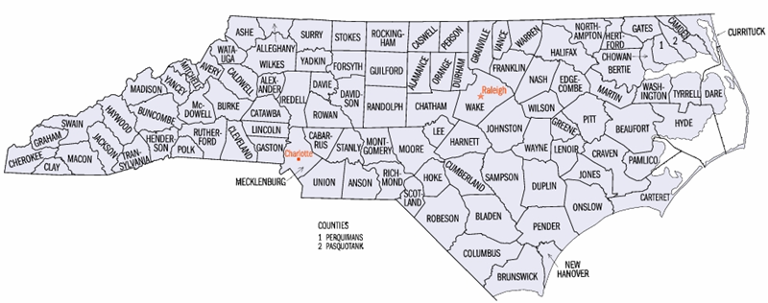
BLUEBERRIES IN NORTH CAROLINA Home garden and pick-your-own plantings exist throughout the state, but our main commercial crop is harvested in southeastern NC (blue area) with an annual farm gate value of $57M (2018). Limited to unique, low pH sand-based organic soils (Leon, Lynn Haven series), or organic muck soils (i.e., Carolina Bays). Approx 10,000 acres total

Slide 4
The best native NC blueberry soils are organic sands (>3% organic matter) with a water table within 12-24” of the surface; fields are not mulched but are bedded to improve aeration in the root zone.

Slide 5
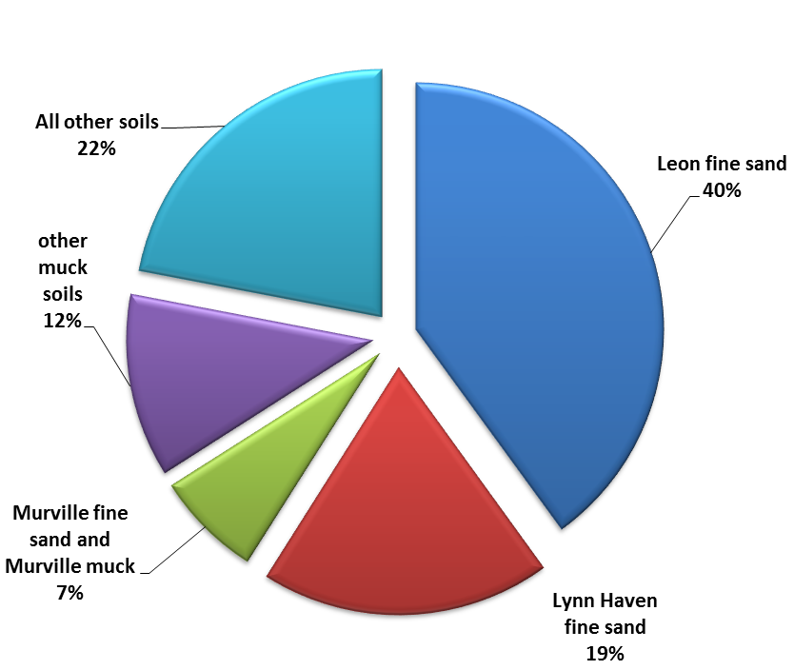
Native blueberry soils for commercial production in NC
(Cline and Bloodworth, 2015)

Slide 6
Blueberry harvest timing by cultivar in southeastern NC (*NCSU)
Cultivar | MAY |  |  |  |  |  | JUNE |  |  |  |  |  | JULY |  |  |  |  |  | AUGUST |  |  |  |  |  | SEP
CROATAN*
REBEL
O’NEAL*
STAR
REVEILLE/BLADEN*
DUKE
NEW HANOVER*
LEGACY
PREMIER*
COLUMBUS*
TIFBLUE
POWDERBLUE*
EARLY >>>MIDSEASON >>>LATE
HIGHBUSH SOUTHERN HIGHBUSH RABBITEYE

Slide 7
FRESH price declines over time, so volume is stacked early in the season
Wk | 1 | 2 | 3 | 4 | 5 | 6 | 7 | 8 | 9 | 10 | 11
 | May (3 wks) |  |  | June |  |  |  | July
$ per lb | 2.46 | 2.4 | 2.1 | 1.89 | 1.74 | 1.57 | 1.45 | 1.38 | 1.36 | 1.45 | 1.44
% of total crop | 10% | 30% | 17% | 16% | 10% | 7% | 3% | 3% | 2% | 1% | <1%
Average NC fresh blueberry returns and volume 2008-2014

Slide 8
Leading states for Cultivated Blueberries, Harvested Acres, 2018 (USDA/NASS) (freeze year in SE)
STATE | ACRES | YIELD/ACRE | FRESH LBS | PROCESS LBS | % FRESH | $/LB | TOTAL VALUE ($)
Michigan | 19,700 | 3,560 | 37,000,000 | 33,000,000 | 53% | 1.00 | 70,000,000
Florida | 5,200 | 3,950 | 20,000,000 | 1,000,000 | 95% | 2.96 | 60,000,000
California | 6,600 | 9,840 | 52,000,000 | 11,000,000 | 82% | 2.20 | 140,000,000
New Jersey | 9,000 | 4,940 | 36,000,000 | 8,000,000 | 82% | 1.42 | 62,000,000
Georgia | 13,300 | 4,100 | 32,000,000 | 21,000,000 | 60% | 1.64 | 87,000,000
North Carolina | 7,500 | 4,500 | 25,000,000 | 8,000,000 | 76% | 1.71 | 57,000,000
Oregon | 13,500 | 10,200 | 60,000,000 | 74,000,000 | 45% | 1.34 | 181,000,000
Washington | 14,400 | 9,470 | 42,000,000 | 94,000,000 | 31% | 1.02 | 139,000,000
UNITED STATES | 89,000 | 6,300 | 305,000,000 | 250,000,000 | 55% | 1.43 | 797,000,000
2018 Maine wild (lowbush) blueberries, 50 million lbs, $0.46 per lb, farm gate $23,155,000

Slide 9
WHY DO THESE STATES PREDOMINATE IN BLUEBERRY PRODUCTION?
Michigan | Native blueberry soils, multi-generational farms since 1920s, moderation of northern climate due to lake effect (Lake Michigan)
Florida | First to market in US. Recent (1980s) industry based on UFL low-chill cultivars. Bark beds or amended sites, highest returns per pound
California | Very early to market in US; Dry climate ideal for organic production. Amended sites with very high yields due to management and climate (1990s)
New Jersey | Native blueberry soils, multi-generational farms since 1910s
Georgia | Some Native blueberry soils, dominant rabbiteye blueberry producer, early to market. Acreage increased dramatically in 1990s and 2000s
North Carolina | Native blueberry soils, multi-generational farms since 1930s, early to market
Oregon | 1970s? Ideal climate, Willamette Valley record yields on amended sites, machine for fresh and processing
Washington | 1970s? Ideal climate, western WA record yields on amended sites, Eastern WA dry climate for organic production

Slide 10
Estimated Costs of Producing, Harvesting, and Marketing Blueberries in the Southeastern United States 2005
C. D. Safley, Ag & Resource Econ.
W.O. Cline, Plant Pathology
C. M. Mainland, Horticultural Sci. (Ret.)
North Carolina State University

Slide 11
Changes since this budget was written
Labor costs up 50%
Equipment costs up 25-50%
Additional equipment costs (soft sorter)
Addition of pre-cooling in packing areas
Increased regulation (GAPs, FSMA, 3rd party audits)
Improved cultivars, Higher yields
Increased machine-for-fresh harvesting
Increased farm size – economy of scale

Slide 12
Procedures
Cost estimates were based on a 100 Acre blueberry planting
Production practices were based on management practices recommended by Extension Specialists and Farmers
Equipment costs were based on 2004 purchase prices
Input prices were collected from farmers and dealers who supply NC blueberry growers
(Safley, Cline & Mainland, 2005)

Slide 13
Yield Assumptions – Good Soil
Years | Irrigation | No irrigation
3 | 2,000 | 1,500
4 | 4,000 | 3,000
5 | 5,500 | 4,000
6 | 7,000 | 4,500
7 – 9 | 8,000 | 5,000
10 -12 | 7,000 | 4,000
13 - 15 | 6,000 | 3,500
16- 18 | 5,000 | 3,000
19 - 20 | 4,000 | 2,500

Slide 14
Yield Assumptions – Marginal Soil
Years | Irrigation | No Irrigation
3 | 1,500 | 750
4 | 3,000 | 1,000
5 | 4,000 | 2,000
6 | 5,000 | 2,500
7 – 9 | 6,000 | 3,000
10 -12 | 5,000 | 2,500
13 - 15 | 4,000 | 2,000
16- 18 | 3,500 | 1,500
19 - 20 | 3,000 | 1,000

Slide 15
Yield Assumptions – Cost to pick & pack
Fresh Market – 80%
60% hand harvested @ $8.29/flat
20% machine harvested @ $5.67/flat
Process Market – 18%
1.8% hand harvested (“fresh rejects”)@ $0.83/lb
16.2% machine harvested @ $0.39/lb
Economic loss – 2%
(Safley, Cline & Mainland, 2005)

Slide 16
Harvest Assumptions
Harvest season lasted 11 weeks – Last week in May through first week in August
Fresh blueberries averaged $14.11 per flat
Processed berries were sold for $0.60 per pound
Note: One flat equals 9 pounds of blueberries
(Safley, Cline & Mainland, 2005)

Slide 17
Equipment Investment – 1st Year
Tractor, 70 – 80 hp (2) | $65,000
Mower, 5ft, HD | 1,000
Fertilizer Spreader | 1,200
Herb Sprayer, 200 gal | 2,000
Shielded Herb Sprayer | 4,000
Tapered Disk, 5ft | 1,800
V-bladed Sweep Plow | 2,000
Drain Runner (spinner) | 1,900
Total | $78,900
(Safley, Cline & Mainland, 2005)

Slide 18
Establishment Costs – 1st Year
Land Clearing ($3,000/A) | $300,000
Ditching & Drainage ($120/A) | 12,000
Forming Beds ($25/A) | 2,500
Plants (1,210/A @ 50¢ /plant) | 60,500
Irrigation Pond (4 – 30,000 cu yd) | 36,000
Irrigation Well (300 gpm) | 15,000
Sprinklers, pipes & valves | 120,000
Pumps (4 – 1,400 gpm) | 38,000
Total | $584,000
(Safley, Cline & Mainland, 2005)

Slide 19
Equipment Investment – 2nd Year
Airblast Sprayer, 220 gal | $7,600
Farm Trailers (4) | 4,000
Total | $11,600
(Safley, Cline & Mainland, 2005)

Slide 20
Equipment Investment – 3rd Year
Truck, 1-Ton | $ 26,000
Mower, Articulated Fail | 12,000
Mower, Flail, 40” | 5,000
Metal Building (125’x50’) | 156,250
Packing Equipment | 35,000
Total | $234,250
(Safley, Cline & Mainland, 2005)

Slide 21
Equipment Investment Costs
4th Year | Harvester, Self Propelled | $114,000
5th Year | Farm trailers (4) | $4,000
6th Year | Packing Equipment (line 2) | $35,000
6th Year | Color Sorter | 70,000
6th Year | Pneumatic Pruners | 12,000
(Safley, Cline & Mainland, 2005)

Slide 22
Estimated Annual Costs, 8th Year
Expense | Good Soil | Good Soil | Mar. Soil
Pruning | $ 297 | $ 297 | $ 297
Weed Control | 144 | 144 | 144
Disease & Insect | 360 | 360 | 360
Irrigation | 477 | 0 | 477
Land Rental | 40 | 40 | 40
Harvest | 6,053 | 3,784 | 4,541
Total | $7,371 | $4,625 | $5,859
(Safley, Cline & Mainland, 2005)

Slide 23
Estimated Annual Receipts & Costs, 8th Year
 | Good Soil | Good Soil | Mar. Soil
Receipts | $10,897 | $6,810 | $8,173
Pruning | - 297 | - 297 | - 297
Weed Control | - 144 | - 144 | - 144
Disease & Insect | - 360 | - 360 | - 360
Irrigation | - 477 | 0 | - 477
Land Rental | - 40 | - 40 | - 40
Harvest | - 6,053 | - 3,784 | - 4,541
Total | $ 3,526 | $2,185 | $2,314
(Safley, Cline & Mainland, 2005)

Slide 24
Flow of Funds – Good Soil
Years | Irrigation | No irrigation
1 | -$804,064 | -$567,974
2 | -$ 58,264 | -$ 31,174
3 | -$193,727 | -$190,434
4 | $ 60,832 | $ 24,867
5 | $247,561 | $180,069
6 | $199,036 | $ 68,489
7 | $379,090 | $217,016
8 | $379,090 | $217,016
9 | $379,090 | $217,016

Slide 25
Flow of Funds – Marginal Soil
Years | Irrigation | No irrigation
1 | -$804,064 | -$567,974
2 | -$ 58,264 | -$ 31,174
3 | -$217,524 | -$226,939
4 | -$ 2,223 | -$101,350
5 | $152,979 | $ 53,743
6 | $ 72,926 | -$ 57,890
7 | $252,981 | $ 90,583
8 | $252,981 | $ 90,583
9 | $252,981 | $ 56,110

Slide 26
Accumulated Cash Flows – Good Soil
Years | Irrigation | No irrigation
1 | -$804,064 | -$567,974
2 | -$862,328 | -$599,148
3 | -$1,056,055 | -$789,582
4 | -$995,224 | -$764,715
5 | -$747,663 | -$584,646
6 | -$548,627 | -$516,157
7 | -$169,537 | -$299,141
8 | **$209,553 | -$82,125
9 | $588,664 | **$134,892

Slide 27
Breakeven Year
The year when enough revenue has been generated to cover start-up expenses.
To secure a loan of shorter duration could leave the farming operation insolvent.

Slide 28
Accumulated Cash Flows – Good Soil
$2,835,534
Irrigation
$1,214,078
Breakeven Year
No Irrigation

Slide 29
Accumulated Cash Flows – Marginal Soil
Years | Irrigation | No irrigation
1 | -$804,064 | -$567,974
2 | -$862,328 | -$599,148
3 | -$1,079,852 | -$826,087
4 | -$1,082,075 | -$927,437
5 | -$929,096 | -$873,694
6 | -$856,170 | -$931,584
7 | -$603,189 | -$841,001
8 | -$350,208 | -$750,418
9 | -$97,227 | -$691,309
10 | **$92,699 | -$632,199

Slide 30
Accumulated Cash Flows – Marginal Soil
$983,152
Irrigation
Breakeven Year
-$576,007
No Irrigation

Slide 31
Conclusions
A new 100A blueberry planting on good soil can be a profitable venture
A new 100A blueberry planting on marginal soil w/o irrigation is a losing venture
A new 100A blueberry planting on marginal soil w/ irrigation can be a risky venture
Irrigation for frost protection and soil moisture pays handsomely

Slide 32
Budgets for Small Plantings
There are lots of blueberry budgets (NC, GA, OR, FL, CA, KY) but none fit our needs exactly for small-scale growers in NC.
Some needs and resources are consistent, others vary widely among locations and farms, such as cost and availability of soil amendments.
Wholesale prices are too low to support small farms.
By “cutting out the middleman” direct-marketing can greatly increase returns to the grower – but you also have to be your own marketer.

Slide 33
Wholesale vs Direct Marketed
US wholesale avg (2018) = $1.43/lb ($7.86/gal)
Pick-your-own = $2.72 to $3.63/lb ($20/gal)
Ready-picked = $2.66 to $5.45/lb ($30/gal)
(One gallon assumed to weigh 5.5 lbs)

Slide 34
Some per-acre establishment costs to consider for small plantings on upland sites (2019 NC prices):
Cultivation, bedding | 140.00
Sulfur/fertilizer | 112.00
Pine bark (100 cu yd) | 1640.00
Drip irrigation lines and labor (two lines per row, pressure-compensated with built-in emitters at 18”) | 3040.00
Plants (2 yr bare-root, 4x10 ft = 1,089/acre) x $2.50 | 2722.00
Planting labor 8 hr x $12.23 (H2A) | 98.00
TOTAL SO FAR…. | $7752.00
Does not include cost of well or filtration system, equipment, fuel, buildings, depreciation or interest, etc.

Slide 35
Small Plantings -- Budgets (continued)
Most budgets estimate blueberry establishment costs at between $8,000 and $9,000 per acre.
Regardless of source (CA, KY, NC) most budgets show net returns of $3,500 to $4,000 per acre.
Where given, break-even points are 7-8 years out.
Irrigation greatly affects long-term profitability.

Slide 36
