Slide 1
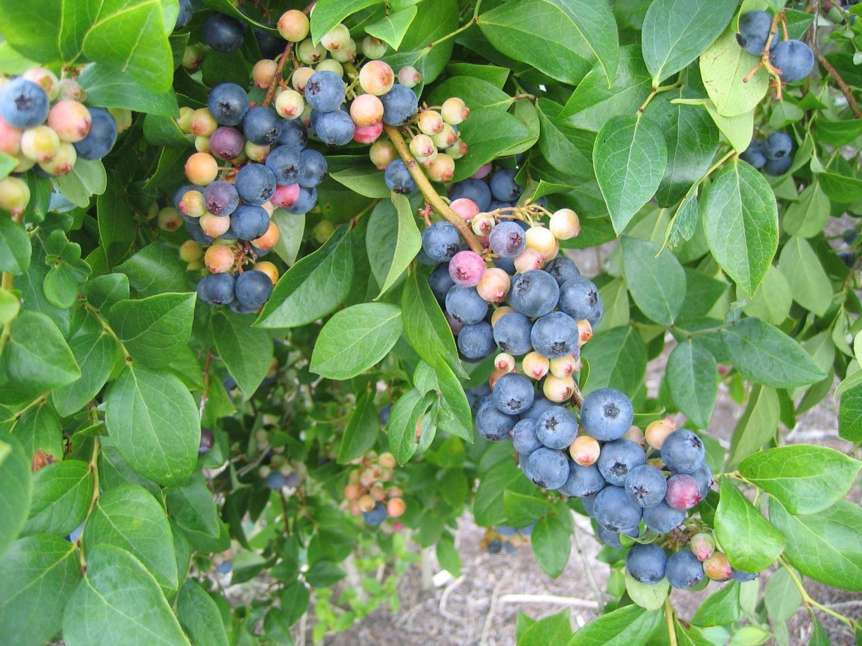

Blueberry Freeze Protection
Bill Cline, Entomology and Plant Pathology
North Carolina State University
Horticultural Crops Research Station, Castle Hayne

Slide 2
Acknowledgements:
Dr. Ronald E. Sneed, Professor and Extension Specialist, Biological and Agricultural Engineering, NCSU
Dr. Charles M. Mainland, Professor and Extension Specialist, Horticultural Science, NCSU

Slide 3
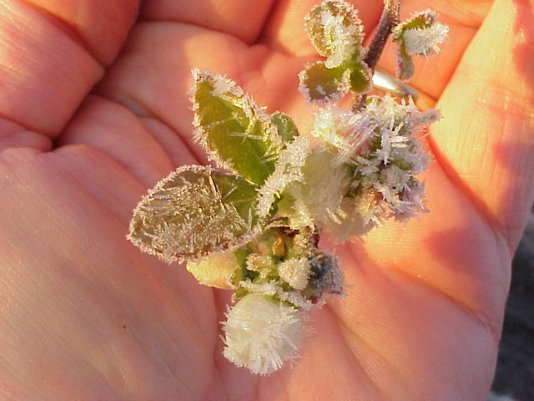
“FREEZE” or “FROST”?
The “FROSTED” object is below freezing (32ºF) but MAY not be damaged.
Damage to blueberry flowers and fruit occurs at ~ 28ºF.
There may or may not be ice crystals we call “FROST” on the bush at the critical 28ºF.
FROST indicates still air, no wind, radiative freeze

Slide 4
Blueberry freeze events in NC
Greatest threat in March, April and May (during and after bloom).
Commercial fields are in low-elevation sites – can be 8-10 degrees colder than predicted low temps.
Overhead irrigation does NOT work very well on windy nights (advective freezes) in MARCH
Overhead irrigation works GREAT to protect against radiation freezes in APRIL and MAY.

Slide 5
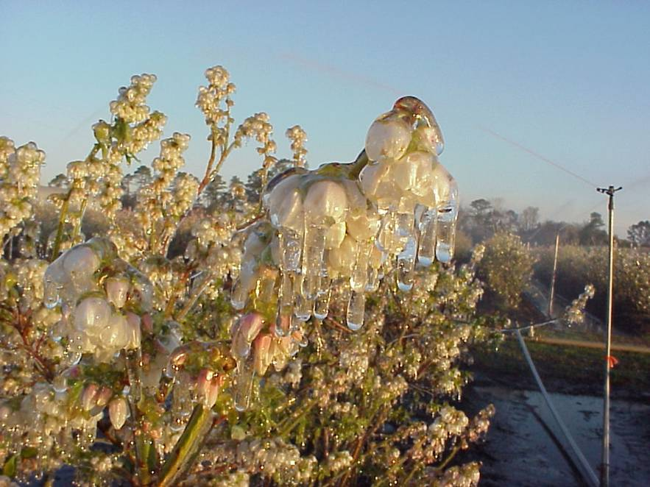
HOW DOES IT WORK?
Phase change of water (liquid to solid) releases HEAT
Freezing water to form ice gives off 80 calories per gram (latent heat of fusion = 80 calories of heat)
This benefit occurs ONLY when humidity is high and water is not evaporating too rapidly – the ice stays WET all night, irrigation never stops

Slide 6
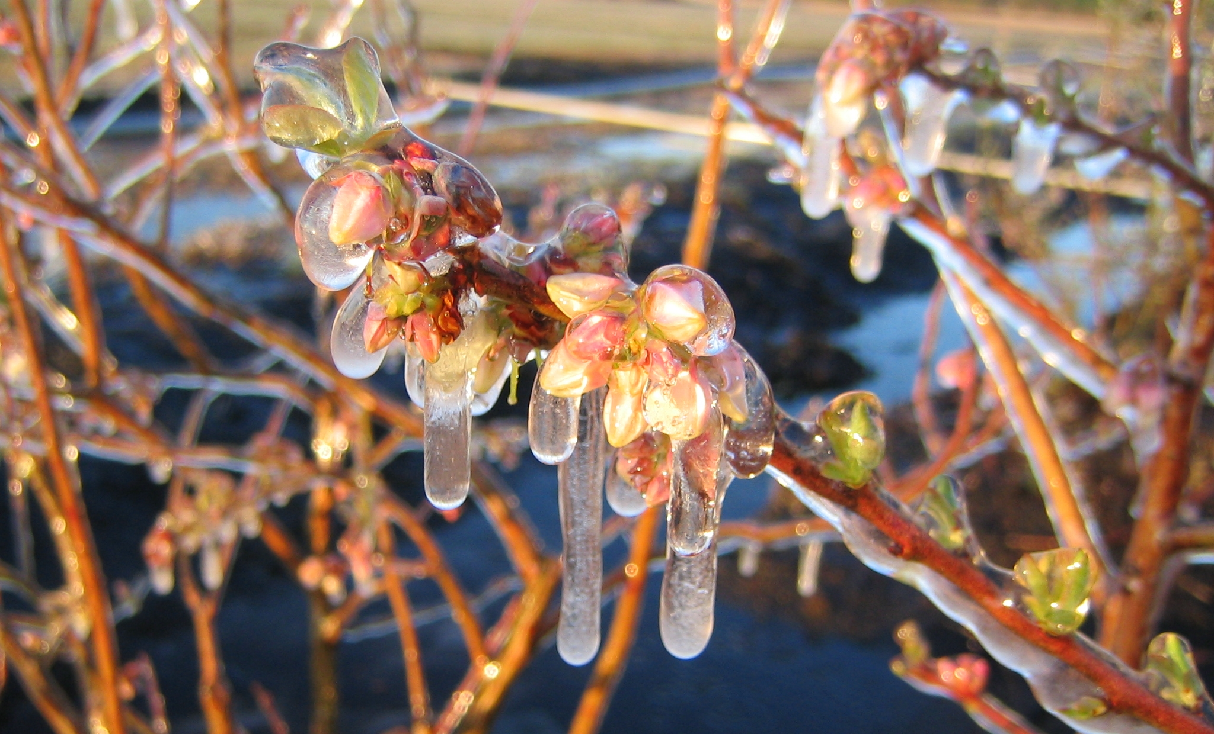
Damage would occur at 28 F, but as long as CLEAR ice is constantly forming, flowers and berries never fall below 32 F, even if air temperatures drop to low 20s.

Slide 7
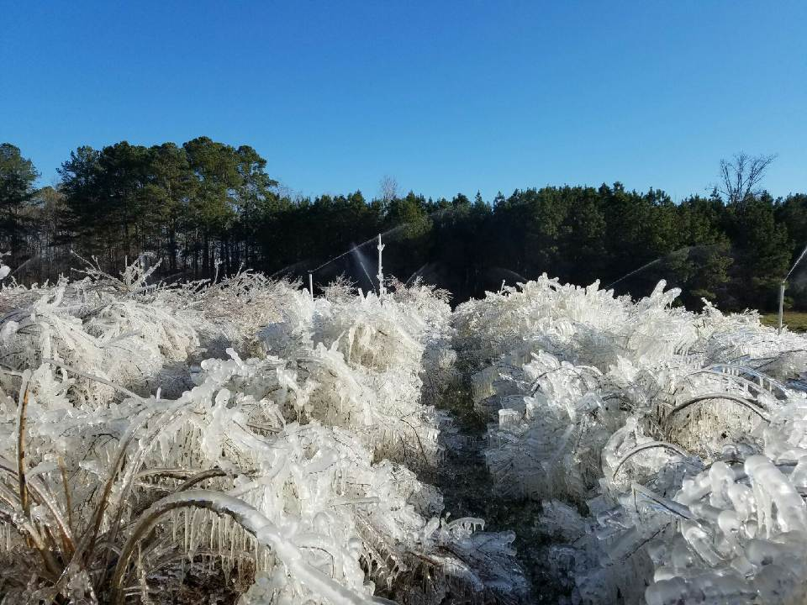
What Happens when it DOESN’T WORK?
Evaporation (liquid to gas) = COOLING
Evaporation of water takes up 600 calories per gram (NEGATIVE latent heat of vaporization = 600 calories of cooling)
So, freeze protection fails in WIND-BORNE freezes where evaporation is excessive
If too windy, ice is white rather than clear, indicating drying and evaporative cooling
Don’t try it on windy nights!!

Slide 8
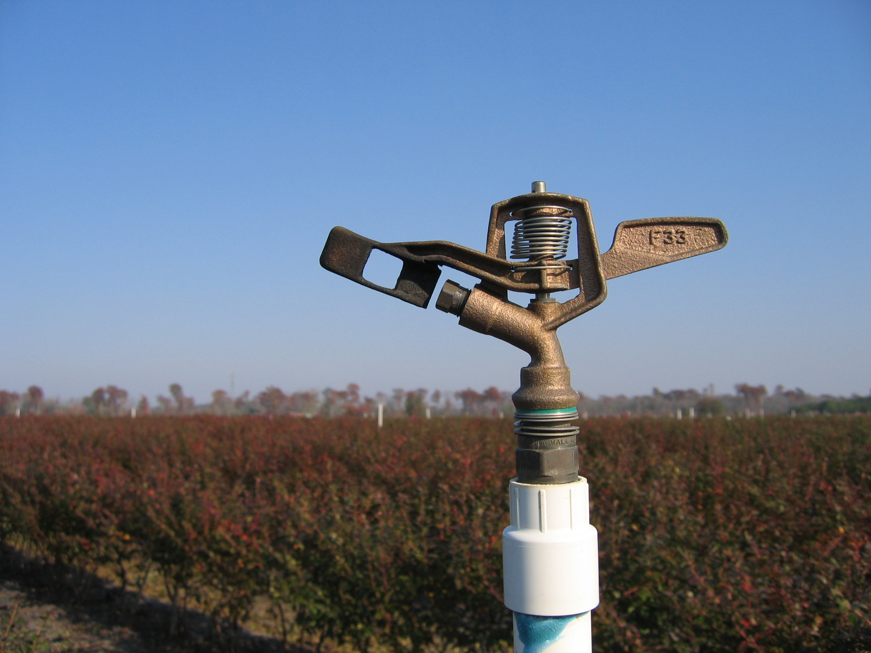
Impact-type sprinklers (usually brass) are used for overhead irrigation, Spring freeze protection and Summer evaporative cooling. 12 per acre @ 5-6 gallons per minute = ~ 68 gpm/Acre

Slide 9
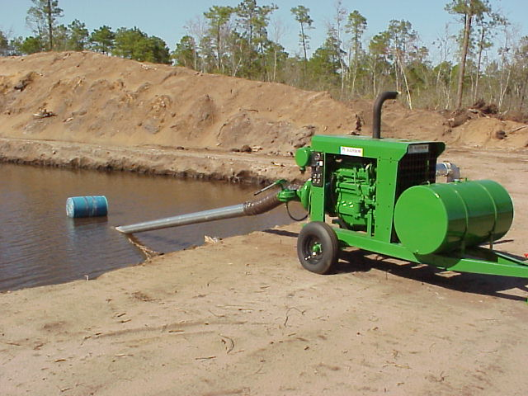
Blueberry irrigation systems in southeastern NC rely on surface water from dug ponds. The water table is close to the surface, so for more water – dig a bigger pond.

Slide 10
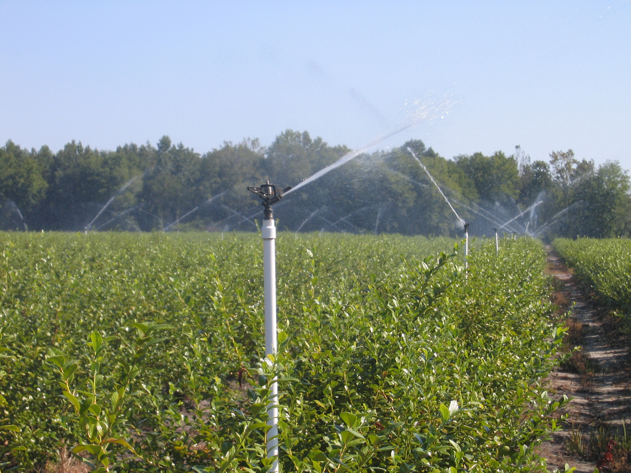
A single pump/pond combination may irrigate 25-30 acres in a typical system.

Slide 11
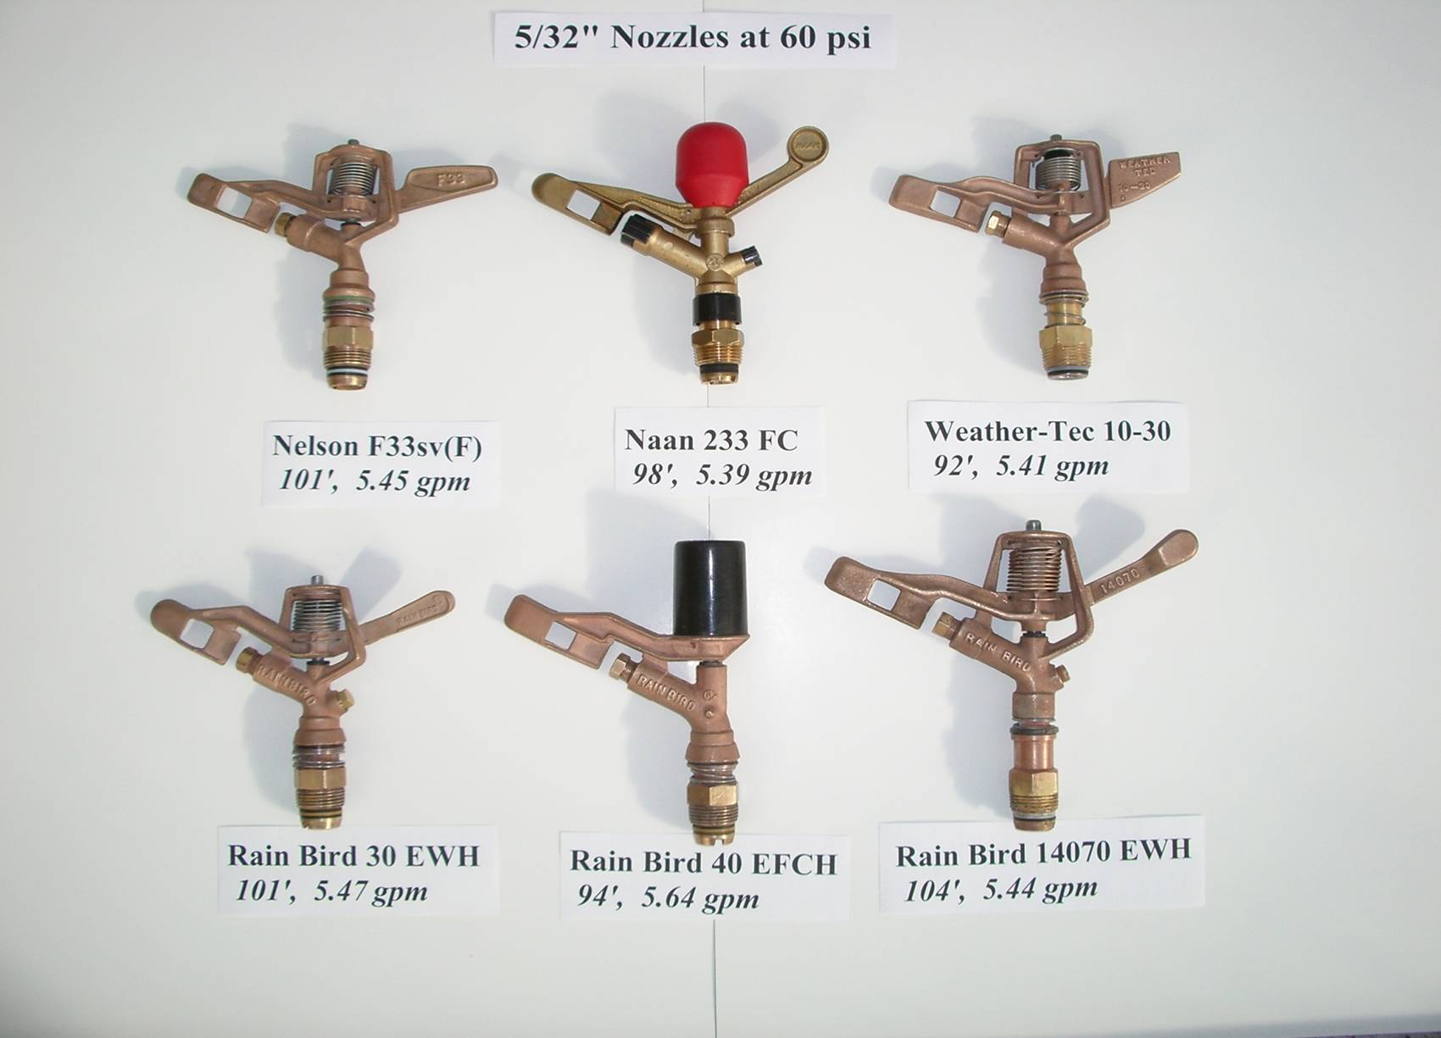
A selection of freeze-protection nozzles used in blueberry
(Photo courtesy Mike Mainland)

Slide 12
How Much Water is Required?
Pumping capacity required (gallons per minute/Acre) for various precipitation rates (inches per hour).
Inches/Hr: | 0.11 | 0.12 | 0.13 | 0.14 | 0.15 | 0.16 | 0.17 | 0.18 | 0.19 | 0.20
GPM/Acre: | 49.8 | 54.3 | 58.8 | 63.4 | 67.9 | 72.4 | 76.9 | 81.5 | 86.0 | 90.5
Source: Tyson, A. W., et al. Frost/freeze protection by sprinkler irrigation. http://www.smallfruits.org/Weather/frost_freeze.htm
= standard blueberry rate in NC is approx 0.15 in/hr, 68 gal/min/A using 12 sprinklers per acre at 5-6 gpm each.

Slide 13
Precipitation rates (Inches/Hr) for selected nozzle capacity and sprinkler spacing.
Sprinkler Spacing (ft.) | Gallons per minute/Sprinkler
 | 2 | 3 | 4 | 5 | 6 | 8 | 10 | 12 | 15
30 x 30 | .21 | .32
30 x 40 | .16 | .24 | .32
40 x 40 |  | .18 | .24 | .30
40 x 50 |  | .14 | .19 | .24 | .29
40 x 70 |  | .12 | .16 | .20 | .24 | .32
50 x 50 |  | .12 | .15 | .19 | .23 | .31
50 x 60 |  |  | .13 | .16 | .19 | .26 | .32
60 x 60 |  |  |  | .13 | .16 | .21 | .27 | .32
60 x 70 |  |  |  |  | .14 | .18 | .23 | .28 | .34
Source: Tyson, A. W., et al. Frost/freeze protection by sprinkler irrigation. http://www.smallfruits.org/Weather/frost_freeze.htm
= standard blueberry rate in NC is approx 0.15 in/hr

Slide 14
Precipitation rates (inches per hour) for blueberry freeze protection at various temperatures and wind speeds. Shaded rates generally require a sprinkler spacing closer than 60x60 feet.
 | Wind Speed (mph)
Min. Temp. ºF | 0-1 | 2-4 | 5-8
27 | 0.10 | 0.10 | 0.10
26 | 0.10 | 0.10 | 0.14
24 | 0.10 | 0.16 | 0.30
22 | 0.12 | 0.24 | 0.50
20 | 0.16 | 0.30 | 0.60
18 | 0.20 | 0.40 | 0.70
15 | 0.26 | 0.50 | 0.90
Source: Gerber, J. F. and J. D. Martsolf. 1965. Protecting citrus from cold damage. Univ. Fla. Agr. Ext. Circ. 287.

Slide 15
NCSU Ideal Tract farm, April 19, 2001. Almost no damage occurred in fields with irrigation protection. Without irrigation many fields lost the entire crop.

Slide 16
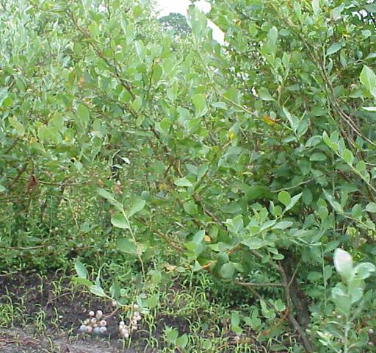
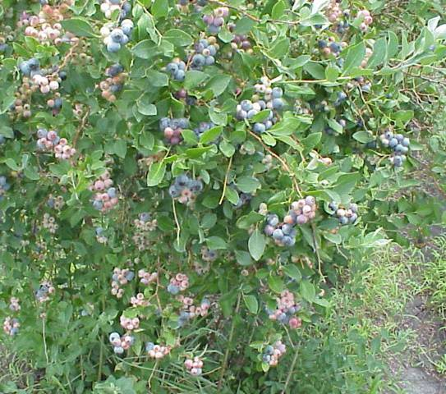
Cultivar Powderblue at harvest in July 2001, following a late spring (post-bloom) freeze event on April 19th.
Unprotected 19 Apr 01
Freeze protected 19 Apr 01

Slide 17
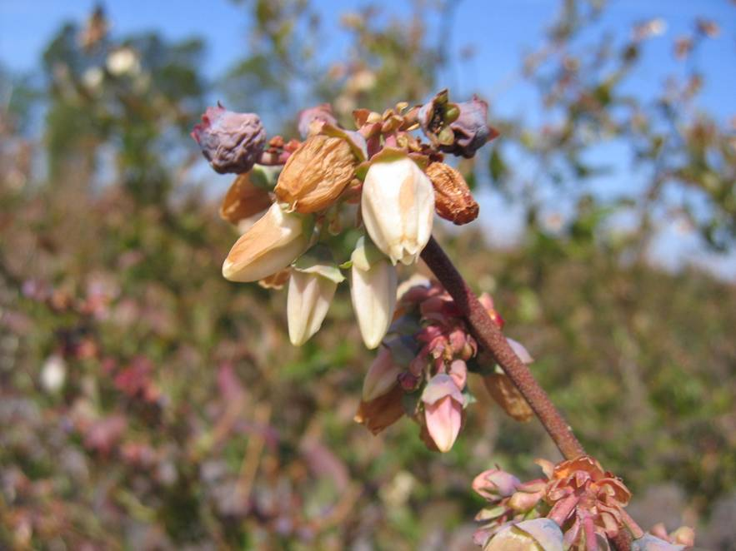
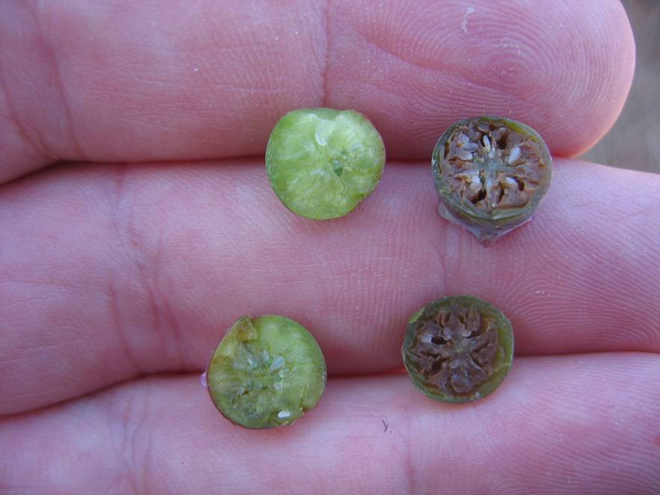
2007 “Easter Freeze”– Over half the NC blueberry crop was lost. Prior to the freeze, the crop was estimated at over 30 million lbs. Surviving production in 2007 was 14.8 Million lbs. Sites with three- to four-night capacity for overhead freeze protection irrigation, AND with minimum temps at 20ºF or above were saved.

Slide 18
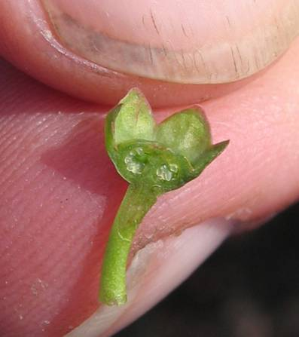
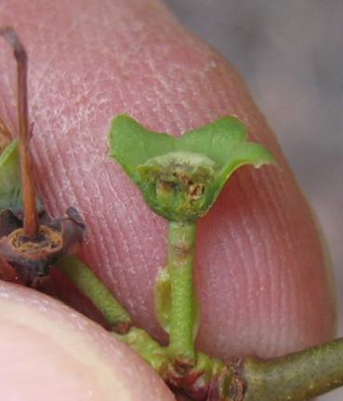
Healthy berry with white ovules (left) versus freeze-damaged. Note browning of ovules in the berry at right.

Slide 19
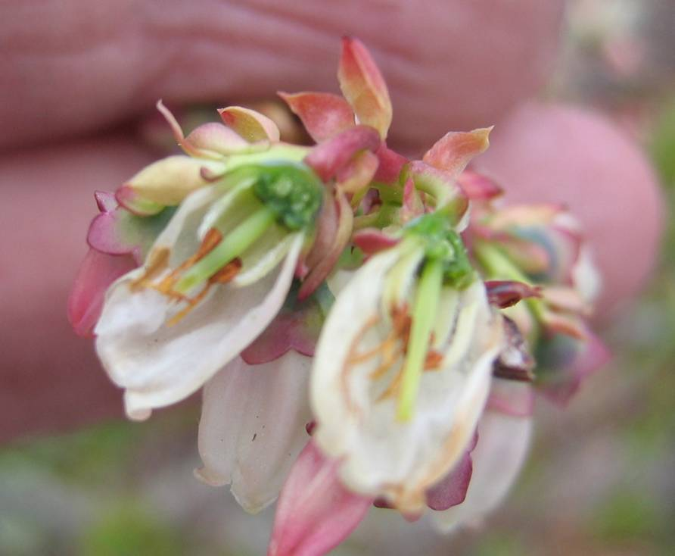
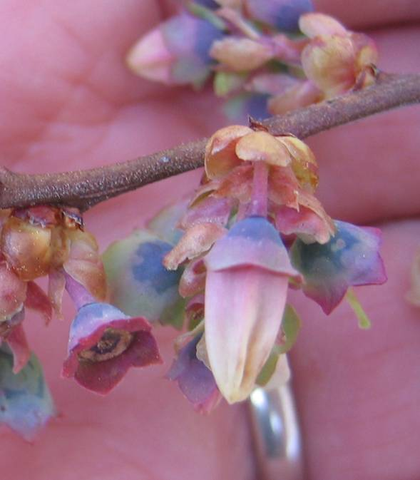
Healthy undamaged flowers (left), cut open to show green ovary and style. Severely damaged flowers (right) are water-soaked after 48 hrs.

Slide 20
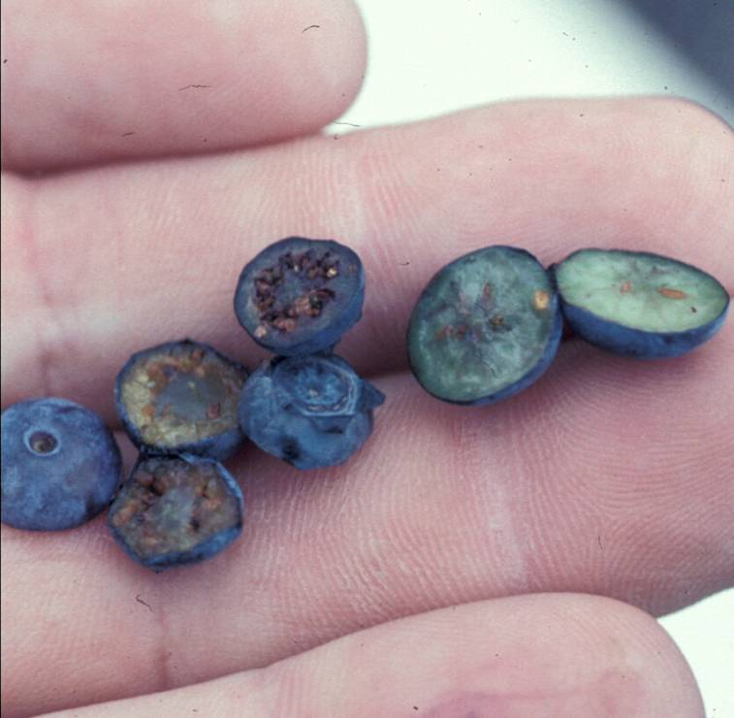
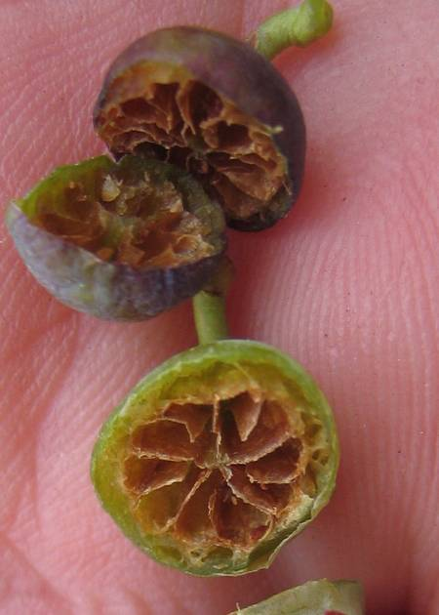
Near-frozen berries may ripen yet have hollow, soft or corky internal damage (right).

Slide 21
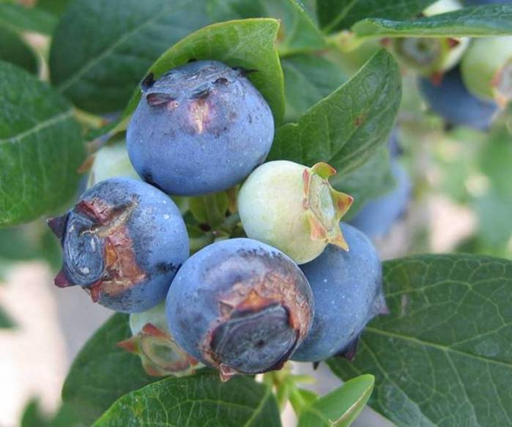
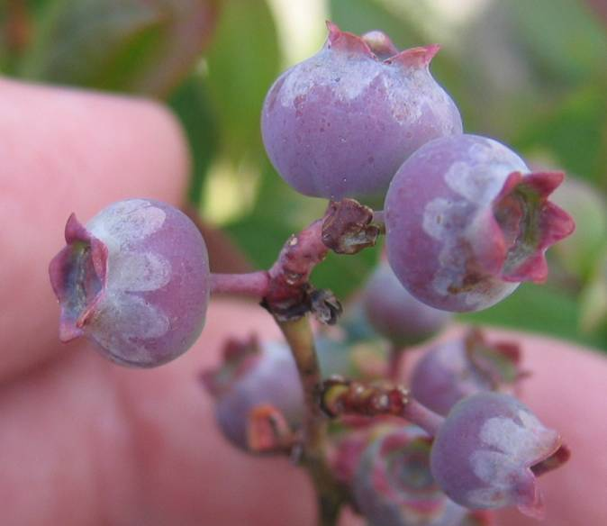
“frost rings” around the calyx that cause berries to split. Shown 48 hr (right) and 1 month later.

Slide 22
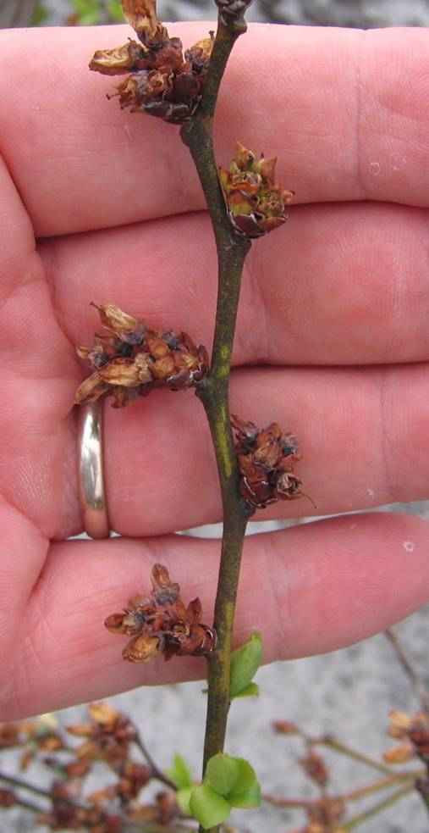
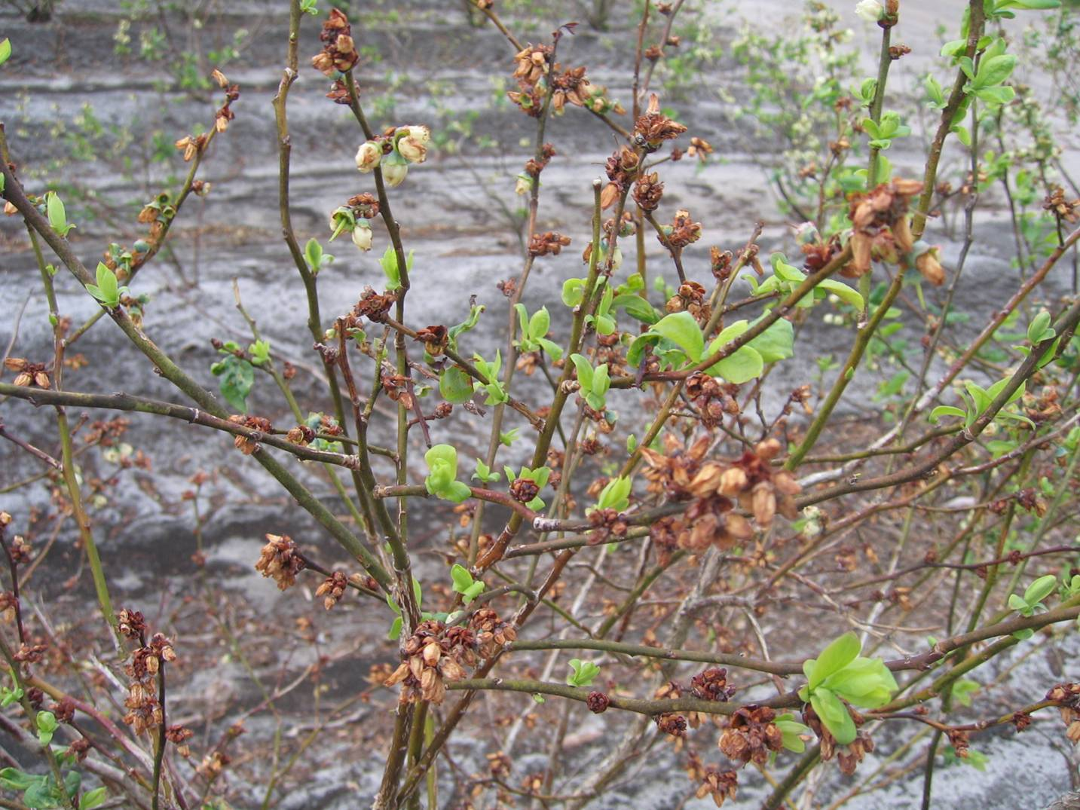
Botrytis flower blight on ‘Duke’ following freeze injury

Slide 23
Schilder, et. al, 2004, 2008, 2015. A Pocket Guide for IPM Scouting in Highbush Blueberries. Michigan State Ext. Bull. E2928

Slide 24
Schilder, et. al, 2004, 2008, 2015. A Pocket Guide for IPM Scouting in Highbush Blueberries. Michigan State Ext. Bull. E2928

Slide 25
Schilder, et. al, 2004, 2008, 2015. A Pocket Guide for IPM Scouting in Highbush Blueberries. Michigan State Ext. Bull. E2928

Slide 26
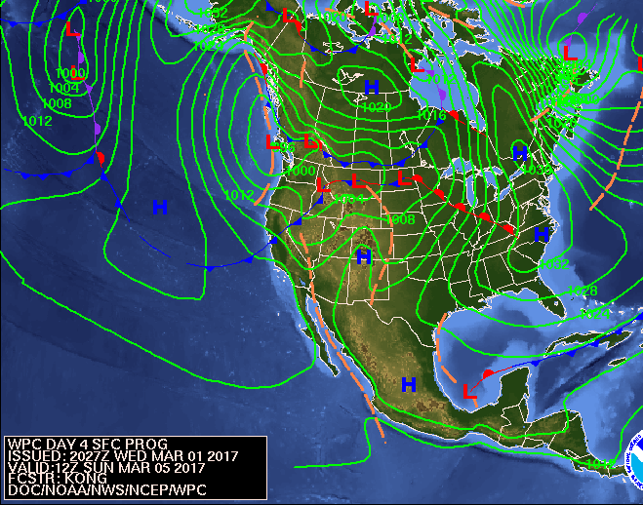

Slide 27
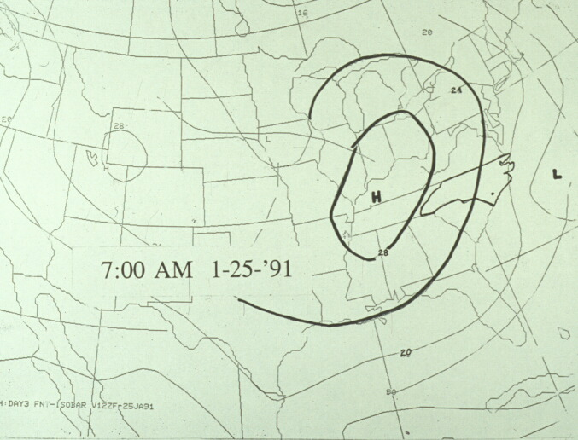
7:00 AM on Day 1 – the high is not quite overhead, some wind can be expected. As the high moves east, clockwise rotation brings cold air down ahead of the system, and warm air up from the south behind the system.
(Photo courtesy Mike Mainland)

Slide 28
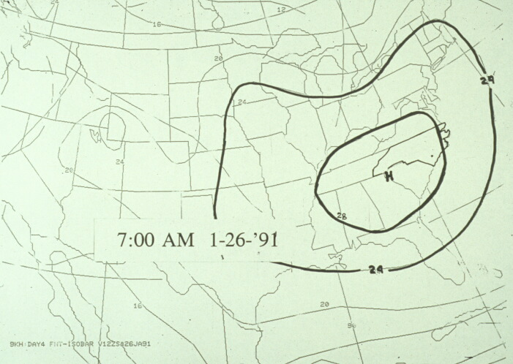
7:00 AM on Day 2 – High is overhead, wind dies down and cold air settles in low areas
(Photo courtesy Mike Mainland)

Slide 29
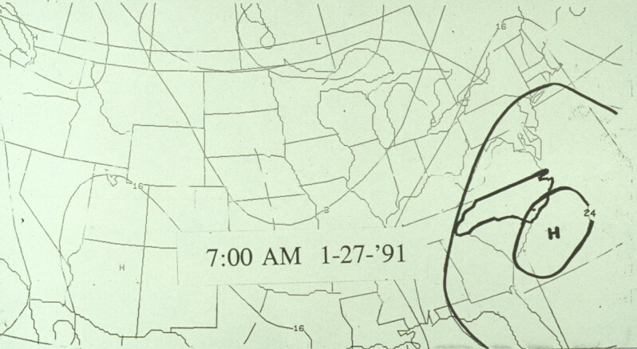
7:00 AM on Day 3 – The high moves offshore, wind increases and temperature rises-- BUT if the high stalls overhead, this can be the coldest morning!
(Photo courtesy Mike Mainland)

Slide 30
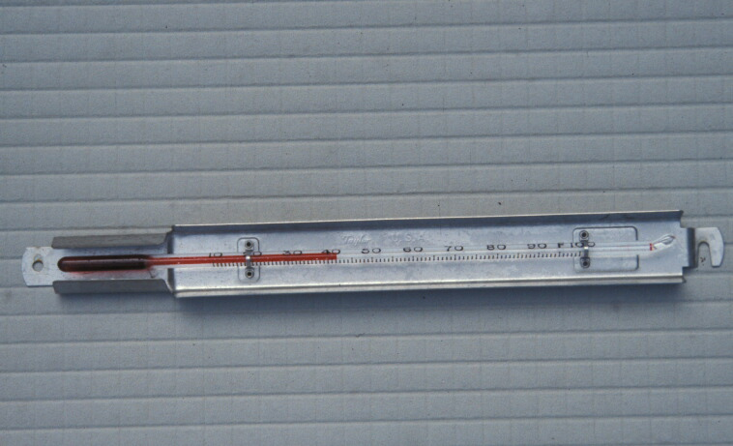
Taylor Minimum-Registering Orchard Thermometers are the type most commonly used in the field
(Photo courtesy Mike Mainland)

Slide 31
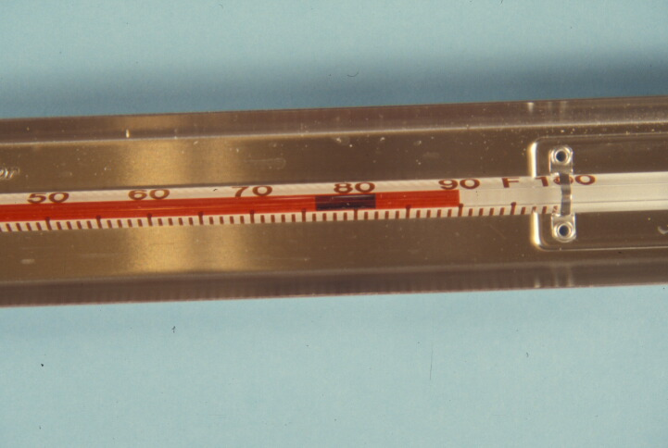
Shows both minimum and current temperature
Even a slight rise above minimum (perhaps 0.1 degrees) can be seen
(Photo courtesy Mike Mainland)

Slide 32
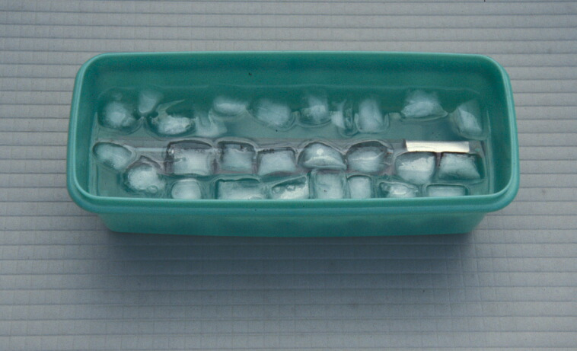
Calibrate using an ice bath (lots of ice, little water, inside a cooler or refrigerator) to 32 degrees
(Photo courtesy Mike Mainland)

Slide 33
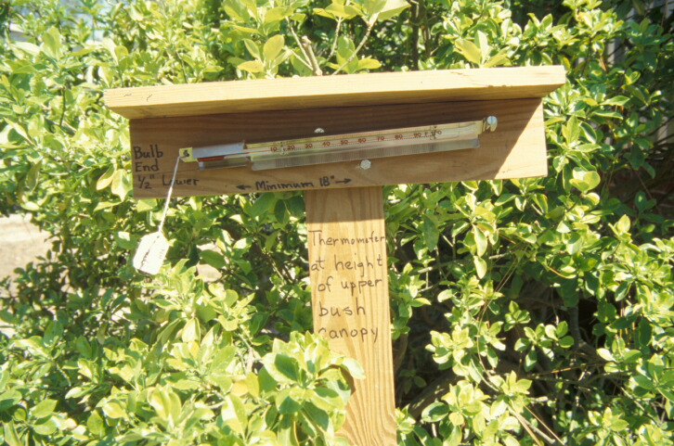
Mounted with bulb end slightly lower, and shaded to prevent direct sunlight
(Photo courtesy Mike Mainland)

Slide 34
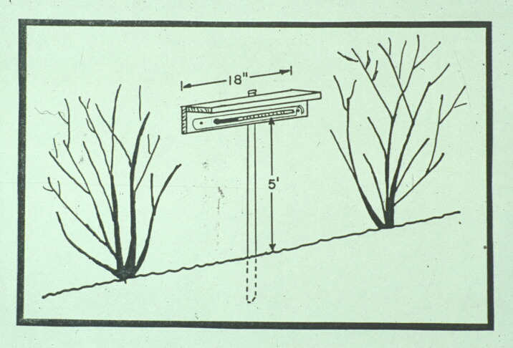
(Photo courtesy Mike Mainland)

Slide 35
1. System Design Considerations
System that will provide at least 0.15” of water/acre/hour (68 gal/min).
Maximum sprinkler spacing 63’ (every 7th row with 9’ rows) x 60’ in the row.
Sprinklers with 5/32” nozzles that will provide a wetted diameter circle greater than 90 ft.
A low-pressure design and pump that will deliver at least 55 psi with less than 10% variation between sprinklers
Pipe size based on flow rates at or below 5 ft/sec

Slide 36
1. (continued) -- Capacity and Water Requirements
Water for more than one night of operation. Desirably 3 nights of 12 hours (31 hours from pond and 5 hours from a well).
A well with the capacity for 5 hours of irrigation after 31 hours will provide 1.5” of water/week during drought.
A well capacity of 4 gal/min/acre is needed.
The 2007 Easter Freeze -- 4 of 5 consecutive nights in most blueberry fields!!

Slide 37
2. Preparation the day before a freeze
Run and check system, repeat if >1% clogs.
Have rain suits, boots, high-intensity spotlights, wires to unclog sprinklers, ½” wrench to remove nozzles, spare sprinklers.
Check drainage around the field.
Check shielded minimum thermometers.

Slide 38
3. Starting, Running and Stopping
Only begin if <28°F is expected for highbush and southern highbush, <30°F for rabbiteye.
On a still night with high humidity, get pumps running by 33°F. With low humidity 36-38°.
Thoroughly wet bushes, then reduce pressure to 40 psi. Increase pressure as temp. drops. Be up to 50 psi by 27°F and 55 psi by 25°F. As 20°F is approached use full pressure.
Run until ice begins to melt and temperature goes above 40° F. Ice should slip freely on stems. If temperature rises slowly and wind begins, be sure ice does not freeze again.
.

Slide 39
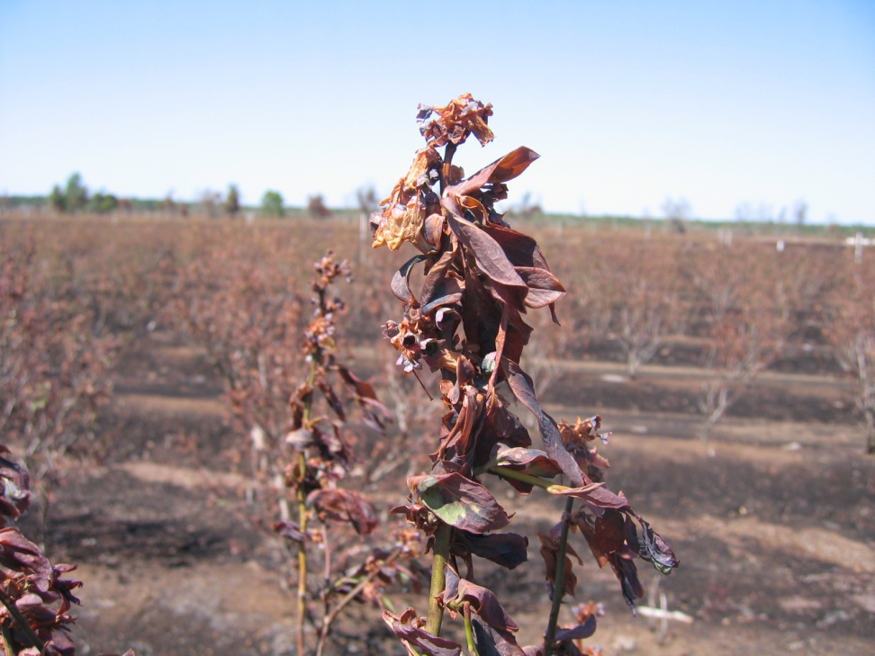
If not done properly, freeze protection irrigation can be more damaging than doing nothing
Poor system design
Too cold
Too windy
Started protecting too late
Shut down too soon
System failure
Ran out of water

Slide 40
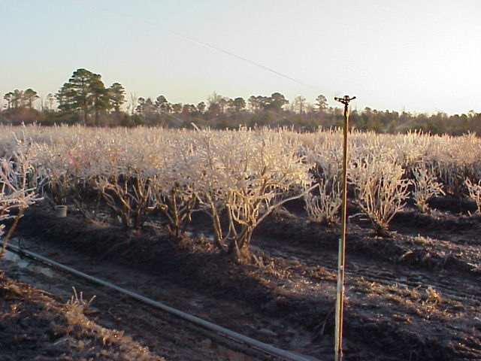
Morning after a successful night of freeze protection. System paid for itself in a single night.

Slide 41
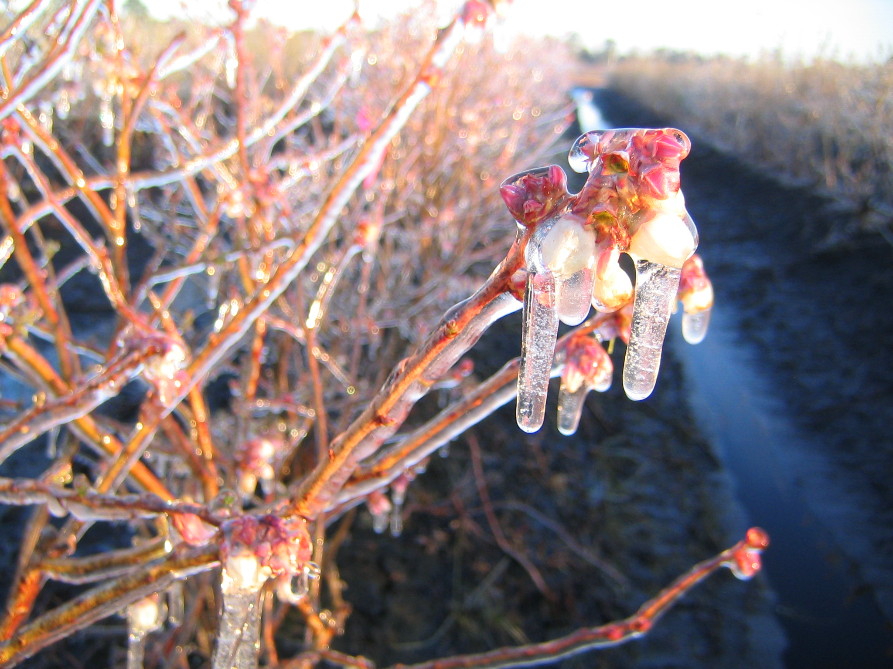
Blueberry Freeze Damage and Protection Measures
http://www.ces.ncsu.edu/depts/hort/hil/hil-201-e.html

